Slide 1
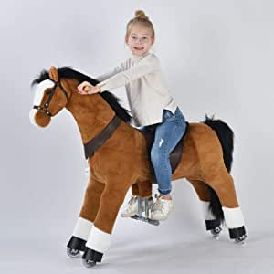




Toy Horse EarlyRiders
Team D In-Person MSBA
David Chen Lee
Jerry Yang
Jessica Zhang
Himangini Banwari
Michael Chung

Slide 2





Post-hoc Segmentation
A Priori Segmentation
TABLE OF CONTENT
Market Simulation
Executive Recommendation
Segmentation based on what provides useful insight
Segmentation based on what provides useful insight
Market simulations with market share and profit numbers that consider competition
Executive summary including key insights and recommendations

Slide 3
01
A Priori Segmentation
Segmentation based on what provides useful insight

Slide 4
A Priori Segmentation
Analyzing profile attribute preferences by coefficients:
Group by respondent data:
by gender
by age
by gender and age
Do regression by:
Adding Interaction effect
Separately inside the segment
some interesting findings:
Girls like more Rocking(motion) and Glamour(Style) type horse than boys.
Older boys (3-4 year old) don't like Rocking

Slide 5
02
Post-Hoc Segmentation
Segmentation based on what provides useful insight
Notes:
Thank you Jerry. I am Himangini Banwari. We also conducted a post-hoc segmentation in order to segregate the customers into segments based on their kids’ preferences.

Slide 6
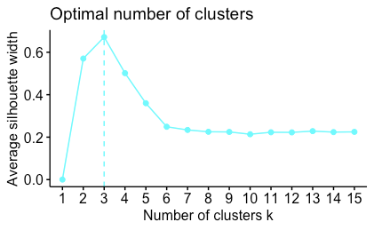
Cluster Analysis
Optimal Number of Cluster = 3
Tested for 2, 3, and 4 clusters
Notes:
Our cluster analysis suggested the optimal number of clusters to be 3. So we tested for 2, 3 and 4 clusters.

Slide 7
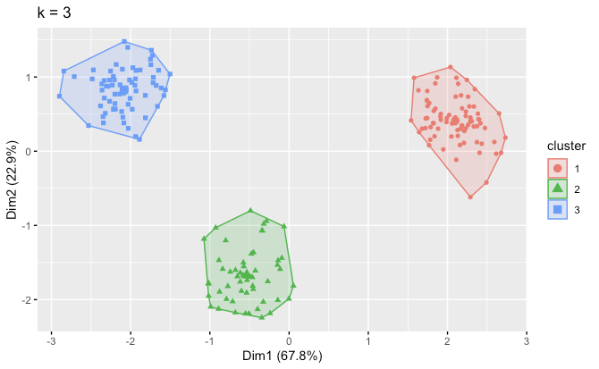
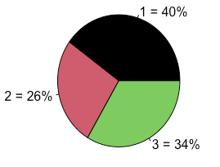
Cluster Analysis
3 clusters
Notes:
We concluded that 3 segments is indeed optimal since we see no overlapping individuals between the 3 segments,
and in each segment, all the respondents have relatively very similar results
As you can see on the pie chart, there is also a fairly good split of 40, 26 and 34 % between the segments

Slide 8
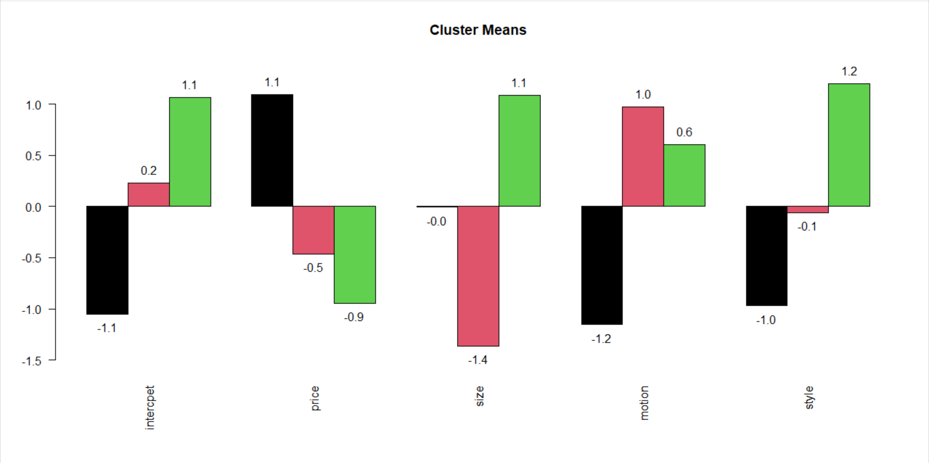
Segmentation Differences
Notes:
Further studying the coefficients of the respondents’ preference in each segment, we made the following observations. We can see that segment 1 which is in black, is more price sensitive than the others, relatively indifferent about size, prefers Bouncing motion and Racing style more. Segment 2 in red, is less price sensitive, prefers smaller size, Rocking motion, and Racing style more. Similarly segment 3 in green, is the least price sensitive, prefers larger size, Rocking motion, and Glamour style more. Now Michael will talk about the absolute preferences and demographics for each segment.

Slide 9
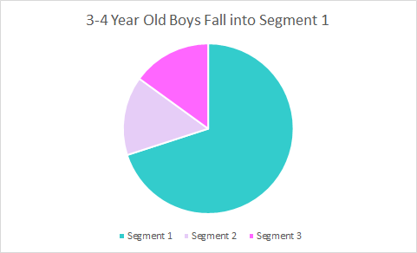
3-4 Year Old Boys Fall into Segment 1
Segmentation 1
3-4 Y/O Males
Prefers a Larger Horse
Active Temperament
Bouncing/Racing Horse
Highly Price Sensitive

Slide 10

Larger Horse
Bouncing
Racing
Low Price
Ideal Product for 3-4 Year Old Boys
Size
Motion
Style
Price

Slide 11
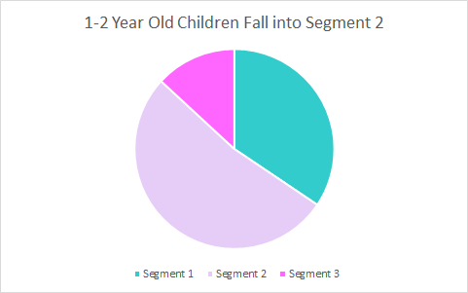
1-2 Year Old Children Fall Into Segment 2
Segmentation 2
1-2 Y/O Child
Prefers a Smaller Horse
Doesn't care about style for child as they're young to know norms
Prefers a rocking horse as it can be less dangerous
Less Price Sensitive

Slide 12
Smaller Horse
Rocking
Glamour
Low Price
Ideal Product for 1-2 Year Old Children
Size
Motion
Style
Price

Slide 13
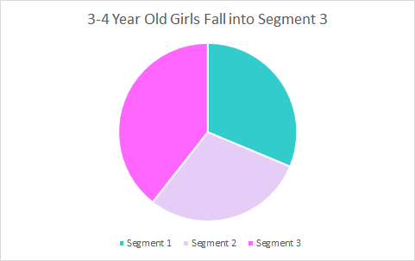
3-4 Year Old Girls Match Segment 3
Segmentation 3
3-4 Y/O Females
Prefers a Larger Horse
Would like a Glamorous Horse
Prefers horse to be rocking
Not Price Sensitive

Slide 14
Larger Horse
Rocking
Glamour
Low Price
Ideal Product for 3-4 Year Old Girls
Size
Motion
Style
Price

Slide 15
03
Market Simulation
Market simulations with market share and profit numbers that consider competition

Slide 16
The market simulation analysis
02
Profits
04
Scenario
01
Market Simulation
03
Comparison
Competitor: 26 inches Rocking Racing Horse with the price of 139.99.
Earlyriders: any other 15 combinations of 1 to 3 models.
Function that calculate and profits of Earlyriders and competitor under any scenario.
Function that can calculate the market share for every model under every scenario
Compare profits and market share under each scenario
Compare the profits and market share between Earlyriders and competitor
Notes:
For our market simulation analysis, we firstly set the scenarios where our competitor would sell toy horse of Profile 7 and EarlyRiders can sell 1 to 3 models of any combination of the other 15 profiles. We input the scenarios to the market simulation function and get the market share and profits under each scenario.

Slide 17
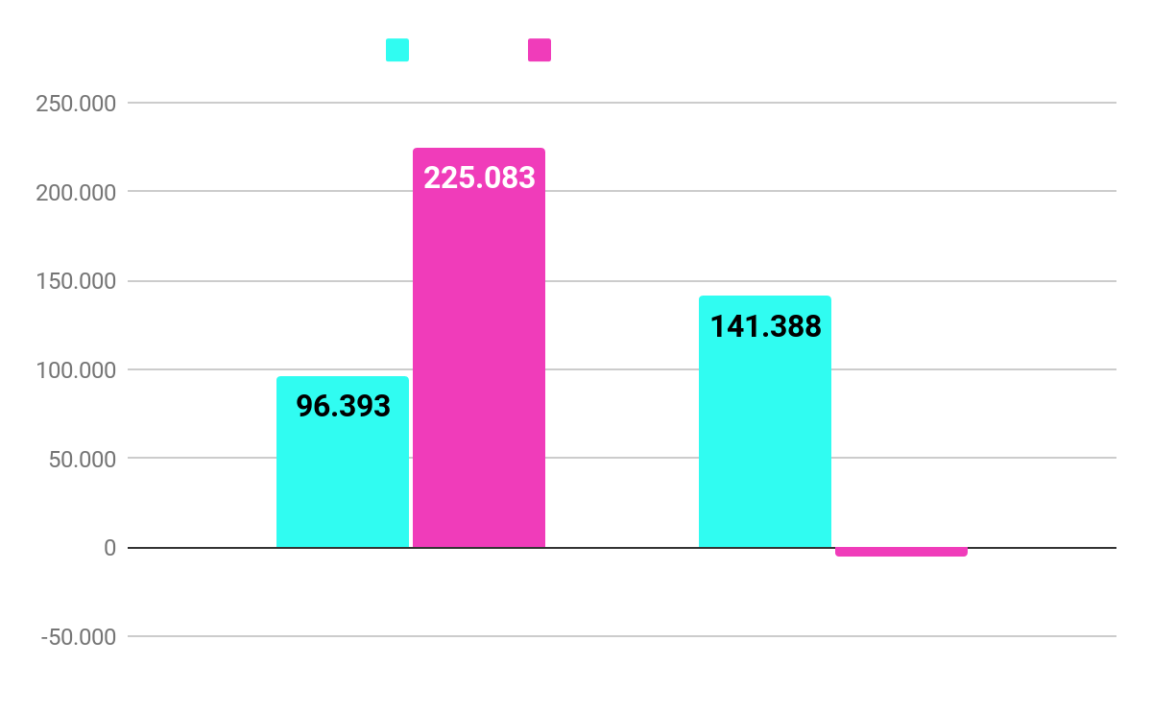
Recommended Policy from Market Simulation
Recommended Policy :
2 NEW products
· 18 inches Bouncing Racing Horse with the price of 119.99 dollars
· 26 inches Rocking Glamour with the price of 139.99 dollars.
Reason:
High market share and the highest profits
Notes:
According to the analysis result, we found that when EarlyRider sell profile 2 and 15 toy horses, the profits would be highest among all the scenarios. So our recommendations policy is: EarlyRiders sell two new products. One is 18 inches Bouncing Racing Horse with the price of 119.99 dollars and the other one is 26 inches Rocking Glamour horse with the price of 139.99 dollars.

Slide 18
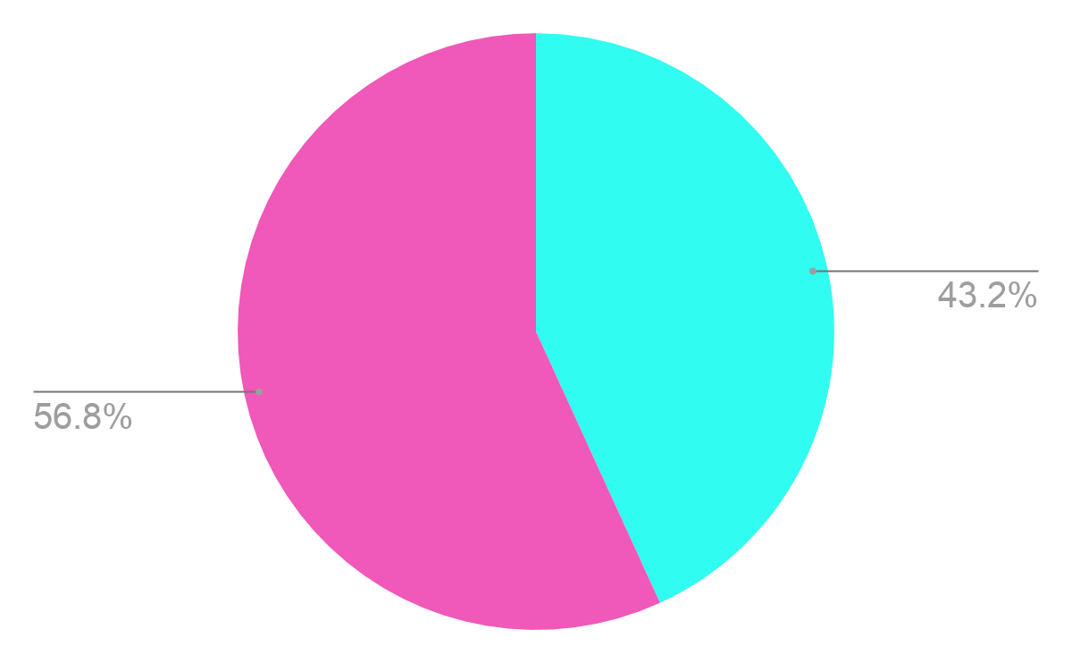
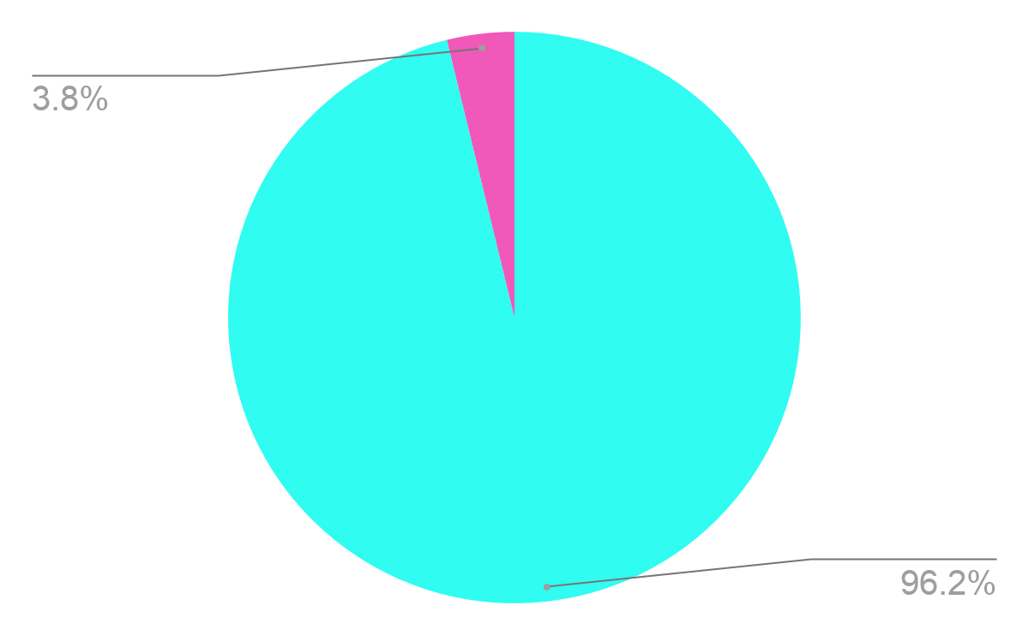
Recommended Policy from Market Simulation
Alternative Policy :
keep 1 offering and change 1 offering
Keep: 18 inches Rocking Glamour Horse with the price of $139.99.
New product: 26 inches Bouncing Glamour Horse with the price of $119.99.
Reason:
Although some cannibalization of horse 13 and lower profits than our recommended plan, this plan can prevent unexpected condition for changing to new line.
Notes:
Moreover, we recommend a more conservative policy with the highest market share among all scenarios. That is Keep the 18 inches Rocking Glamour Horse with the price of $139.99 and offer 6 inches Bouncing Glamour Horse with the price of $119.99.
In this case, the profit is not as high as our recommended plan, but this plan can prevent unexpected condition for changing to new line.

Slide 19
04
Executive Recommendation
Key Insights and Takeaways

Slide 20
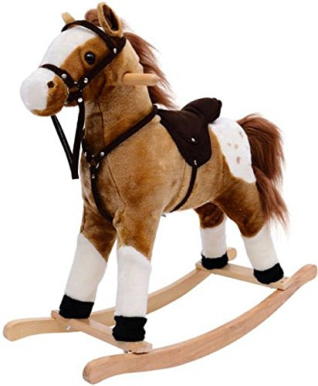
Pricing Recommendation
Rocking & Glamour Horses
Prefer for Segment 2 and 3 customers
Buyers are less price sensitive
Should charge a higher price and offer no discounts
Bouncing and Racing Horses
Prefer for Segment 1 customers
Buyers are more price sensitive
Wise to charge a lower price and offer discounts to increase sales
Female segmentations (2 & 3) are mostly non price sensitive
Should charge higher prices and offer no discounts
Notes:
Bouncing Racing
Rocking Glamour
18 inches Bouncing Racing Horse with the price of 119.99 dollars
· 26 inches Rocking Glamour with the price of 139.99 dollars.

Slide 21
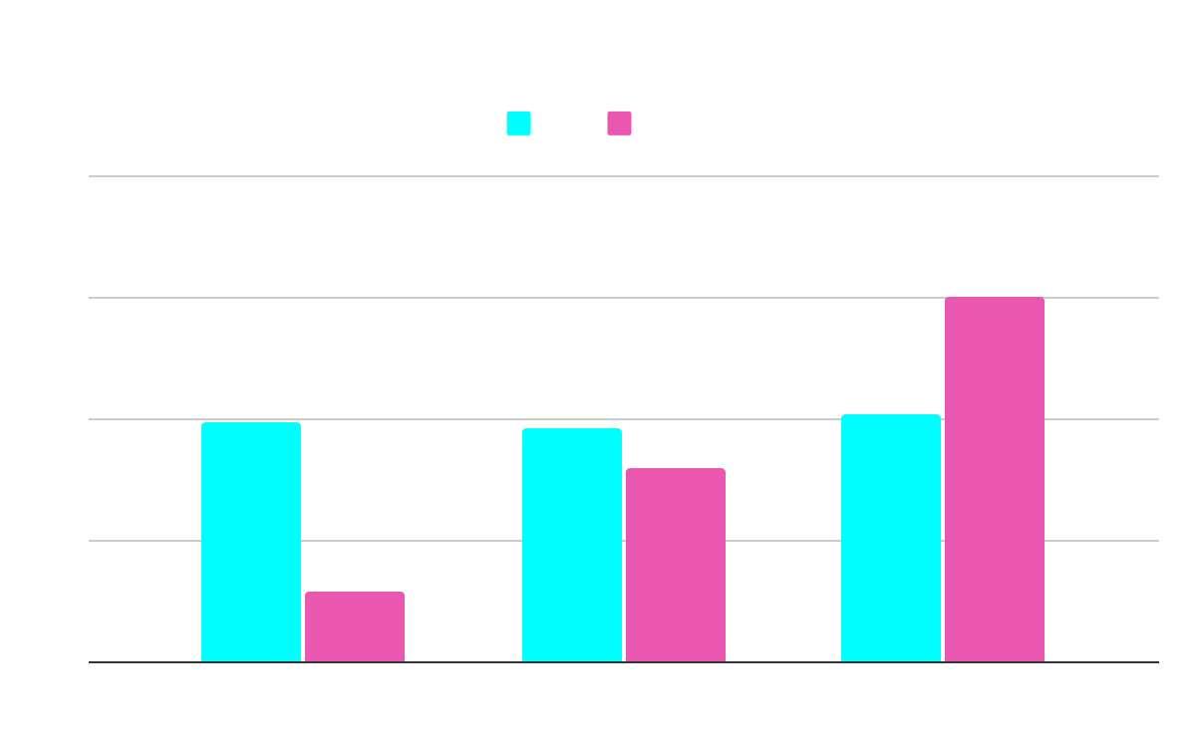
Insights from the overall analysis
General recommendation:
With our 2 new products, we will target the segmentation of 3-4 year old girls more.

Slide 22
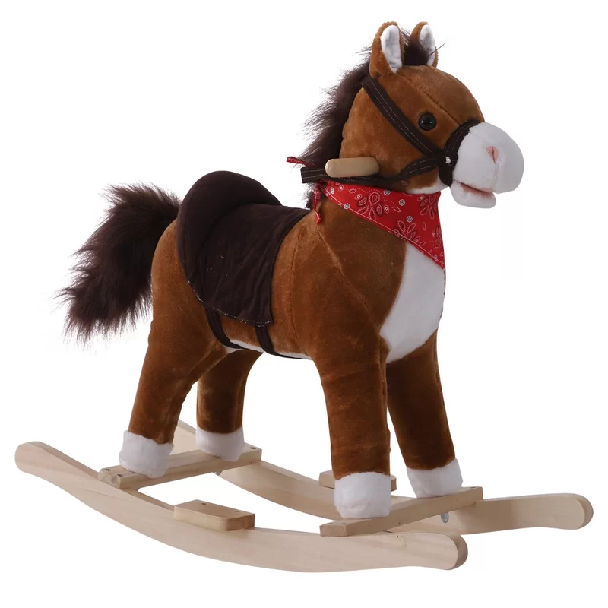
Overall Recommendations:
There is no need for discounts, since our customer will be less price sensitive.
Make cute decorations to make the products more attractive to girls, since our target would be mainly be 3-4 years old girls.

Slide 23

THANK YOU!
Q & A

